Slide 1


Lecture 7:
Feed Forward
Neural Networks
McGill Artificial
Intelligence Society

Slide 2
Today’s Agenda
Motivation and biological inspiration
Feed forward neural networks
Hidden Units and Activation Functions
Output Units
Universal Approximation Theorem
Learning and backpropagation
Activity: Introduction to Python keras library

Slide 3
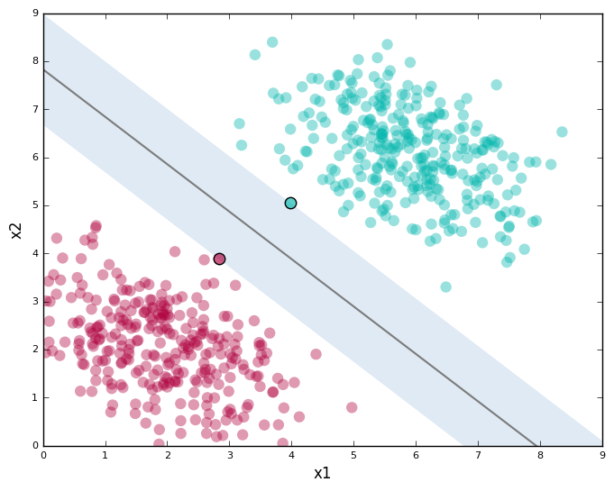
Motivation
So far we’ve mostly tackled simpler forms of data
e.g. linearly separable data
Image Courtesy
Notes:
Unlike many other prediction techniques, ANN does not impose any restrictions on the input variables (like how they should be distributed). Additionally, many studies have shown that ANNs can better model heteroskedasticity i.e. data with high volatility and non-constant variance, given its ability to learn hidden relationships in the data without imposing any fixed relationships in the data. This is something very useful in financial time series forecasting (e.g. stock prices) where data volatility is very high.
For example, you can’t assume that for images of different classes, you’ll be able to linear classify between samples from different classes.
Neural networks are used to learn more complex, non-linear relationships between your input data. So why do we call them neural networks? (Slide)

Slide 4
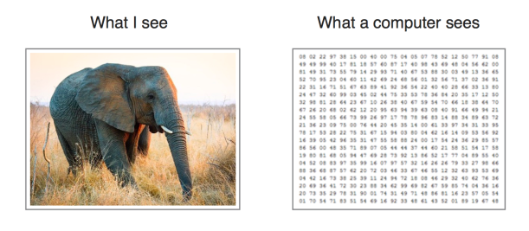
What about more complex data?
Neural networks can learn complex, non-linear functions
Non-parametric model (versus linear regression, which assumes a set of parameters that fully specifies a Gaussian distribution, e.g. mean variance)
Does not impose fixed relationships in data (does not assume inherent distribution data is sampled from)
e.g. better at modeling non-constant variance
Notes:
Unlike many other prediction techniques, ANN does not impose any restrictions on the input variables (like how they should be distributed). Additionally, many studies have shown that ANNs can better model heteroskedasticity i.e. data with high volatility and non-constant variance, given its ability to learn hidden relationships in the data without imposing any fixed relationships in the data. This is something very useful in financial time series forecasting (e.g. stock prices) where data volatility is very high.
For example, you can’t assume that for images of different classes, you’ll be able to linear classify between samples from different classes.
Neural networks are used to learn more complex, non-linear relationships between your input data. So why do we call them neural networks? (Slide)

Slide 5
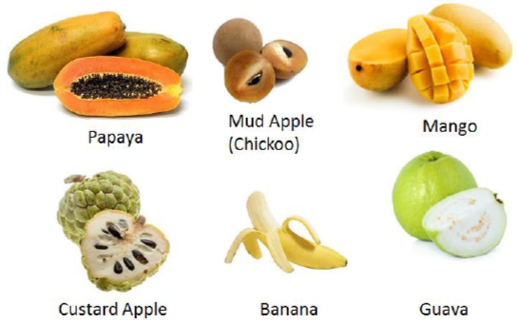
What do neural networks do?
Today, we’ll be tackling feed forward neural networks - the fundamental basis of all neural networks
Other names: deep feed forward neural networks, multilayer perceptrons (MLP)
Basis of many modern commercial applications
Stepping stone in understanding CNNs, RNNs
Goal: simply put, neural networks are used to approximate some function f
Example: classification, regression

Slide 6


What do neural networks do? (Ct’d)
Example: classification
is a function that maps input x to a discrete output variable (category) y
Feedforward NNs will then define a mapping:
→ the neural network then learns the value of the set of parameters 𝚹 that result in the best function approximation
What does this function approximation look like? What does 𝚹 look like?
Easier to understand given visual graph of neural network, biological inspiration.
Notes:
Recall that for linear and logistic regression, the parameters learned were the W and b parameters of the affine/linear model

Slide 7
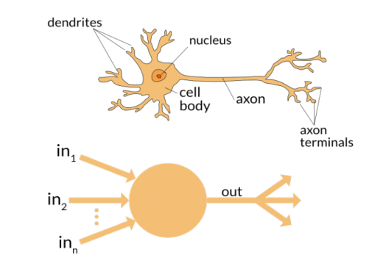
Biological Inspiration
Notes:
Basically, the neural network was first inspired by the biological neuron, or brain cell, although neural networks in AI have definitely deviated from this original source of inspiration. However, one of the key takeaways from this biological phenomena remains the similarities between a biological neuron, and an artificial neuron.
This lies mostly in the input/output structure, where we take a weighted sum of the inputs, apply an activation function, threshold its value and output a numerical value (Slide)

Slide 8
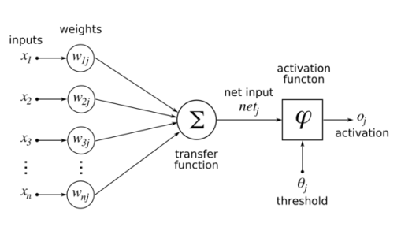
Biological Inspiration
Notes:
Basically, the neural network was first inspired by the biological neuron, or brain cell, although neural networks in AI have definitely deviated from this original source of inspiration. However, one of the key takeaways from this biological phenomena remains the similarities between a biological neuron, and an artificial neuron.
This lies mostly in the input/output structure, where we take a weighted sum of the inputs, apply an activation function, threshold its value and output a numerical value (Slide)

Slide 9
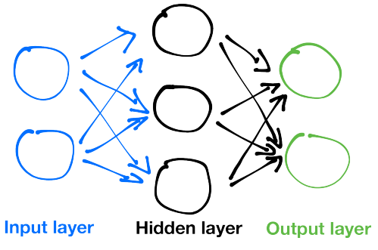
Neural Network Visualization - Directed Graph
Notes:
When you combine a lot of these neurons together, you get a network of neurons, aka a neural network (Slide)

Slide 10
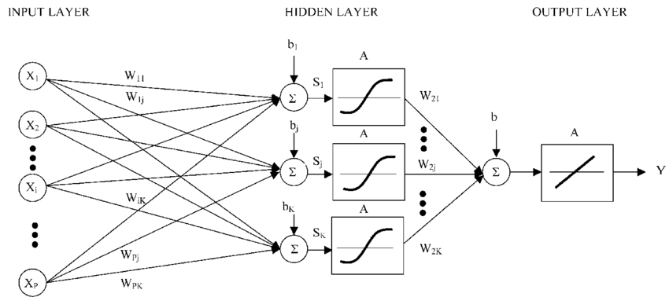
Neural Network Visualization - Directed Graph
Notes:
Just another visualization, this time with more detail as to what goes on in the hidden units! Now, let’s take a look at how the nodes interact and make a prediction!

Slide 11
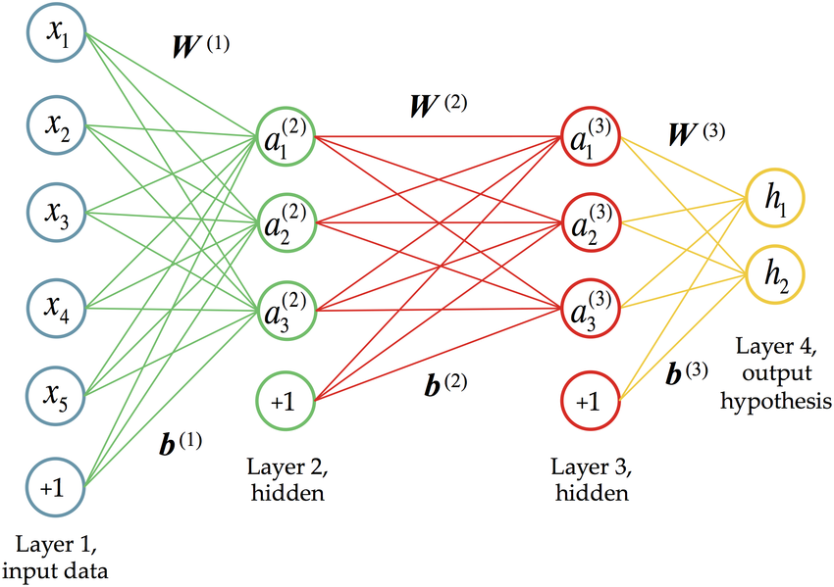

Biological Inspiration - A Layered Architecture
Outputs of layer k would serve as the inputs to layers k+1 → “feedforward” (no feedback connections)
“Networks” : typically represented by composing a chain of different functions:
Input Layer: takes in input data (size corresponds to input space)
Hidden Layer: neurons hidden from view (this is where the magic happens)
Output Layer: neurons in this layer provide the output of the network
Notes:
So, this is where the magic begins. One neuron is able to learn a simple function, but a network of neurons can learn MUCH more complex functions. In a traditional neural network, we always have an input layer, one or more hidden layers, and the output layers. Basically, as the arrows indicate, the output of the input layer flow into the hidden layer, whereas the outputs of the hidden layer “flow” into the output layer. As such, the outputs of layer k would serve as the inputs to layers k+1. There are no feedback connections in which outputs of the model are fed back into itself (not even within intermediate steps)
When there are feedback connections, they’re called recurrent neural networks, or RNNs
Point to f1, f2, f3 → the length of the chain is what gives the depth of the model
Now, take a look at what’s going on in each of the hidden units

Slide 12
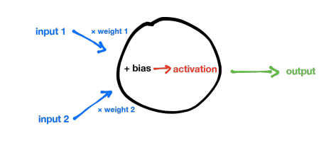
The Hidden Unit
Given a vector of inputs X…
Compute an affine transformation on X → z = W^{T} X +b
Inputs X to the neuron are multiplied by weights W
Bias b then summed with weighted inputs
Non-linear activation function g(z) applied on z
For most hidden units, the sole difference lies within the form of the “activation function” g(z)!
Notes:
This slide basically shows a reduced version of the previous figure,where our input space lies in R2. (Ask class if neuron framework reminds them of anything) - ans: logistic regression using sigmoid function (Slide)

Slide 13
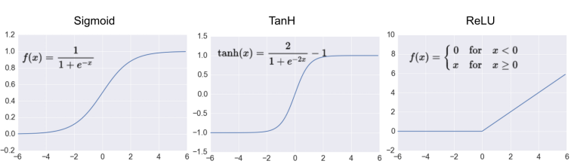
Activation Functions
For gradient descent to work, we need activation functions that are:
Continuous
Differentiable: to compute gradients for each activation function *
Monotonic: the error surface associated with a single-layer model is guaranteed to be convex
Image Credits
Notes:
Apart from the sigmoid/ logistic function, there are other functions used as “activation” within each neuron. There are just a few conditions to choose these functions, three of them being (read slide)
(Slide)

Slide 14
Activation Functions
The set of weights from all the hidden units form the set of parameters 𝚹 the network learns
As with parametric learning algorithms, neural networks also learn via gradient descent (why we need differentiable activation functions in the hidden layers)
NOTE: In practice, the activation function just needs to be differentiable at most points, e.g. ReLU’s gradient is undefined at x = 0
Image Credits

Slide 15
A Note On Choosing Activation Functions
Still an experimental field, no definitive rules by default
ReLU is typically a good choice, does not experience vanishing gradient problem sigmoid and TanH functions have (also faster)
Predicting which activation function work best in advance is impossible in practice
Design Protocol - Trial and Error
Pick a hidden unit you think will work well for neural network.
Train network with that type of hidden unit.
Evaluate network performance on validation set.
Notes:
Ask class: How does one relate the perceptron to a sigmoid? (Then go to graphing visualization)

Slide 16

A Brief Note on Output Units
So far we’ve only talked about activation functions in hidden units. Depending on the task at hand, we define an appropriate output unit activation function, and corresponding cost function.
Can imagine the output of the hidden layers as a set of hidden features to the output layer:
Then, the role of the output layer is to transform the set of hidden features to complete the task the network must perform

Slide 17
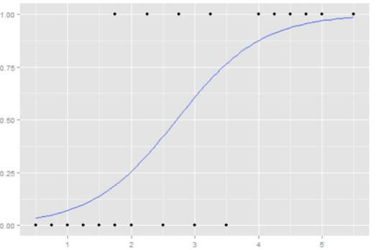
A Brief Note on Output Units
For regression, can use linear unit → hidden features are the inputs of a linear model
For binary classification, can use sigmoid → hidden features are input of logistic regression
Many other activation functions possible

Slide 18
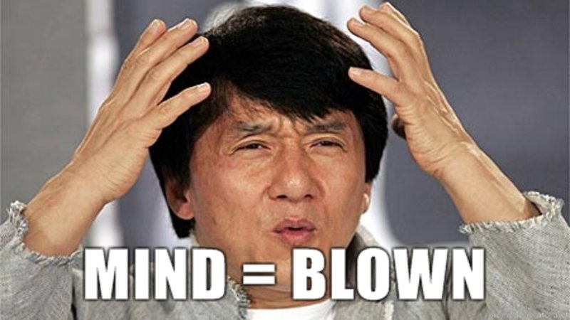
Essentially, a neural network learns features that are more interpretable* for the output layer, which simply consists of a layer of neurons that performs tasks that we have previously seen...
Notes:
Interpretable: linearly separable for classification, or minimizes regression error for regression problems

Slide 19
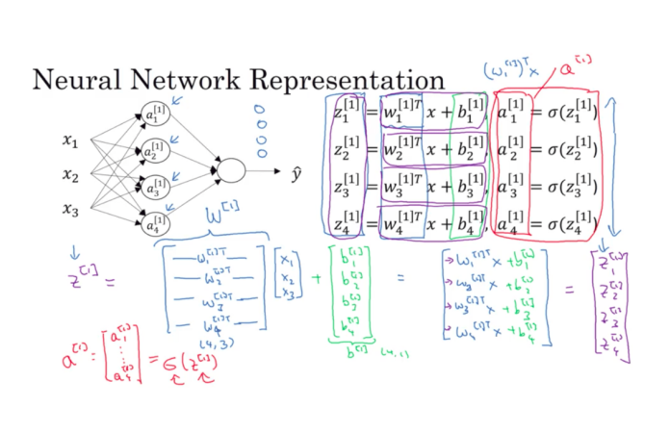
Neural Networks in Matrix Form
Notes:
Go over flow from input to output, showing how a single prediction is made - this is what we call “forward propagation”

Slide 20
Neural Network Expressivity
Notes:
So let’s take a more geometric interpretation of a neural network’ s learning capability. After seeing what the hidden layers in a neural network do, it’s easier to talk about how expressive a neural network is. By expressivity, we usually mean how complex of a function a neural network can learn. When comparing with, for example, logistic regression, we were able to find a threshold between two classes by essentially using a single sigmoid neuron . (Slide)

Slide 21
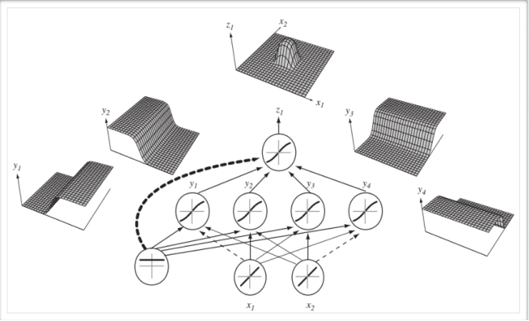
Neural Network Expressivity
Image taken from Hugo Larochelle's Slides
Notes:
With many hidden units in neural networks, we are able to learn more complex thresholds between your input space and desired output, instead of the simple linear decision boundaries we’ve seen in previous learning algorithms. This idea is similar to kernels, which maps instances from one feature space to another feature space that is more interpretable, e.g. linearly separable, except you don’t need to specify the kernel beforehand.

Slide 22
Neural Network Expressiveness
Neural networks approximate functions without assuming an initial data distribution.
Universal Approximation Theorem
“Every bounded continuous function can be approximated with
arbitrary precision by a single-layer neural network” (Hornik, 1991)
In practice, use deeper models instead:
Can Reduce number of units required to represent desired function
Can reduce generalization error
Notes:
Instead, learns the non-linear manifolds in the data using a network of neurons with non-linear activation functions
Hornik: But might require a number of hidden units that is exponential in the number of inputs (worst case is one hidden unit for each input configuration)
So a feedforward neural network with a single layer is sufficient to represent any function, but layer could be unfeasibly large, and can fail to generalize correctly → use many layers instead
So now we have a bunch of theorems that tell us how accurate a neural network can be in terms of function mapping, great! Are all our problems solved? Not really… although we can guarantee arbitrary precision from NNs, we lose other practical advantages..

Slide 23
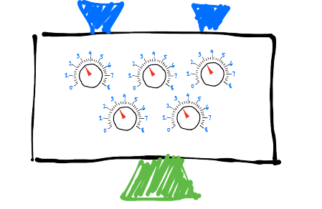
Learning in Neural Networks
From an interpretability point of view, the neural network seems like a black box
Neural networks as a black box: Modern networks often times have hundreds of millions of parameters, sometimes even billions
Since we have so many parameters to learn, need lots of data
How do we learn these parameters?

Slide 24

Learning Algorithm - Gradient Descent
Goal: algorithm which lets us find weights and biases so that the output from the network approximates y(x) for all training inputs x.
No closed form solution to approximate weights, so once again we use the gradient of our objective function to learn network weights.
Example: for regression tasks (assuming Gaussian distribution), use Least Mean Squares Loss at output layer of the neural network

Slide 25
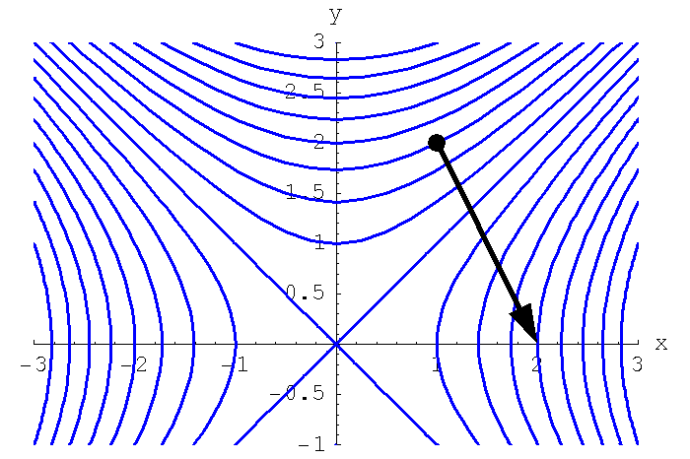
Learning Weights Via Gradient Descent
Notes:
To quantify, or measure, how well we're achieving this goal of finding good network weights, we once again define an objective function, also referred to as a cost/loss function. Remember that for an algorithm to learn via gradient descent, what we really want to do is simply learn algorithm parameter weights that minimize this objective function!

Slide 26
Gradient Descent Procedure
Specify the neural network architecture:
Input layer size → how many input features we feed into network
Output layer size, output unit type → depends on output shape, task at hand
Hidden units/layer, number of hidden layers*
Initialize weights to small random numbers.
Repeat following until convergence:
Forward pass
Backpropagation
Compute share of error at the output unit
Propagate share of error for hidden units
Gradient Descent
Update each network weight based on gradient
Notes:
On choosing the optimal number of hidden units/layer, number of hidden layers, there is no definite answer or formula to follow whatsoever. Typically, we start with smaller architectures for a given task and evaluate performance on a validation set before moving to larger, more time and computationally expensive models to train.

Slide 27

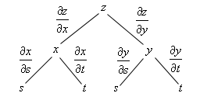
Backpropagation
Recall that we can describe a feedforward neural network via a chain of functions, or a composition of multiple functions that ultimately computes our hypothesis, or output.
In practice, we use the chain rule to propagate the gradients for each hidden weight in the neural network, and partial derivatives to account for each component up the eventual update in the gradient phase:
Wikipedia Source

Slide 28

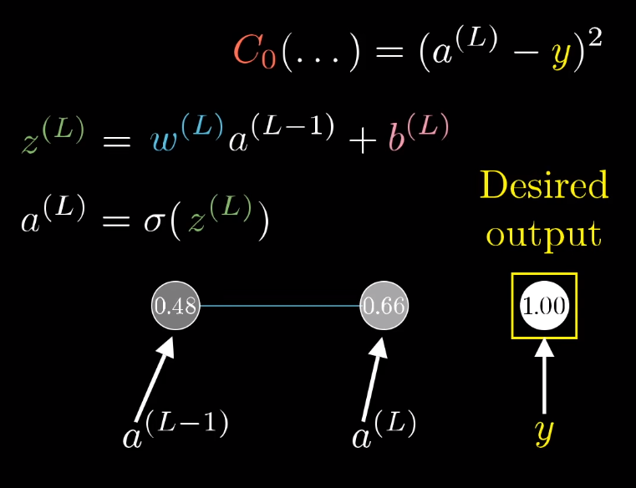
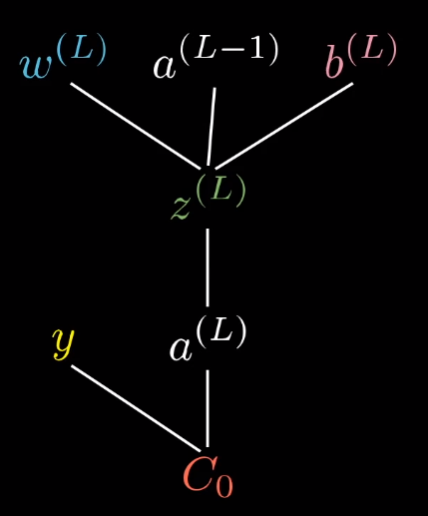
Backpropagation - A Simple Example
Youtube Source
Notes:
Let’s imagine a very simple example, where we have a neural network with two layers of neurons, with a single neuron in each layer. For notation’s sake, let’s call the last neuron aL, then the previous neuron feeding into it would be called a L-1. We’ll be learning this under a supervised learning context, so we know what the desired output for this single training instance is, denoted by y. Let’s use the LMS function to be the cost function. To relate the prediction of the network aL to what we’ve seen before, the output of the previous neuron is taken, multiplied by some weight, with some bias added to it, then we pass it through some non-linear activation function. Let’s call this term z(L).

Slide 29
Backpropagation - A Simple Example
To compute the gradients that help update each parameter in the neural network, we Start from the output neuron of the NN:
Looking for the ratio, or the rate of change, that the weight w^{L} has on C₀:
Youtube Source
Notes:
Notice in this scenario, that we cannot directly compute the change of the cost function relative to the weight wL directly! We use the chain rule to find out how C0 is affected by the activation function aL, which is in turn affected by the weighted sum zL, from which we can finally compute the change with respect to the weight wL.

Slide 30
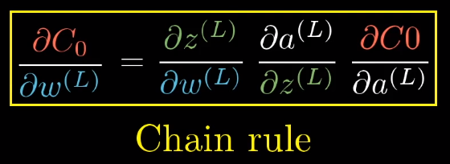
Backpropagation - A Simple Example
To compute the gradients that help update each parameter in the neural network, we Start from the output neuron of the NN:
Looking for the ratio, or the rate of change, that the weight w^{L} has on C₀:
Youtube Source
Notes:
Notice in this scenario, that we cannot directly compute the change of the cost function relative to the weight wL directly! We use the chain rule to find out how C0 is affected by the activation function aL, which is in turn affected by the weighted sum zL, from which we can finally compute the change with respect to the weight wL.

Slide 31
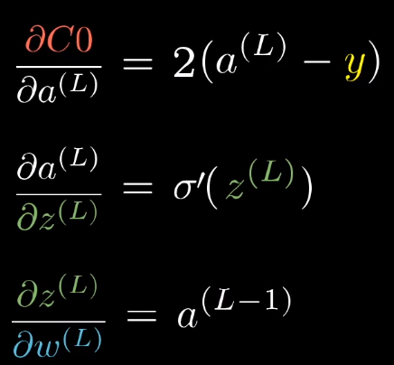
Backpropagation - A Simple Example
Youtube Source
Notes:
Let’s take a step back and look at what the derivatives actually mean:
The first derivative is simply the ROC of the cost function wrt the output of the activation function of the neuron in the last layer L
The second derivative is the ROC of the non-linear activation function, e.g. the derivative of a sigmoid, ReLU, etc.
As for the 3rd derivative, we can see that the ROC of the weight is based off how strong the activation of the previous neuron is
Now, we’ve developed an expression for the “influence” of a single weight on the output of the neural network, but this is only for a single training example, and only for a single neuron.

Slide 32
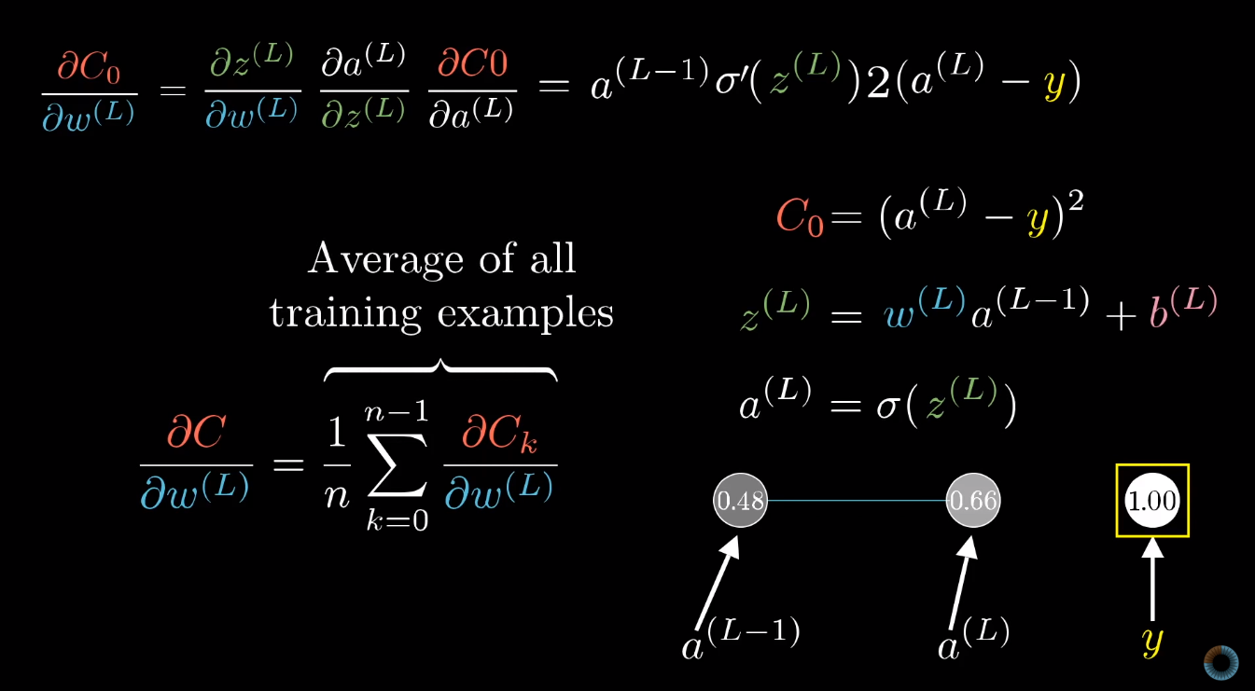
Backpropagation - A Simple Example
:
Notes:
Tying it all together, we’ve only studied the expression for the cost function error over a single example. To generalize to our training data, we compute this error over all the training examples to see the expected influence of a single weight, wL, on the cost function. This expression was used just to understand how a single weight is updated, and can be extended to many hidden layers.

Slide 33
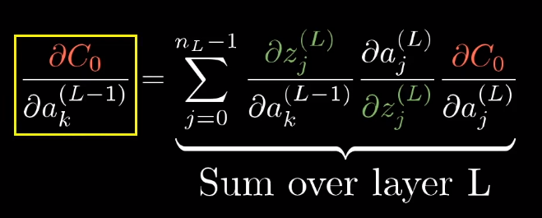
Backpropagation - A Simple Example c
:
Notes:
TO DO Clarify here: https://www.youtube.com/watch?v=tIeHLnjs5U8

Slide 34

So Now What?
Initialize weights to small random numbers
Repeat following until convergence -
Forward pass
Backpropagation
Compute share of error at the output unit
Propagate share of error for hidden units
Gradient Descent: Update each network weight based on gradient
α is the “learning” rate - we want to choose a low value so that the weight update doesn’t oscillate the network too much (weights will not converge to optimal value)
Notes:
We’ve done most of the work now, we just have to use the gradient previously computed to update the new weight value, using the equation in the box. (Read off alpha). If alpha is too small however, we also won’t converge because the weights are updating too slowly and might get stuck at a saddle point in the cost function. (Slide)

Slide 35
Forms of Gradient Descent
Stochastic Gradient Descent: compute error using a single sample at a time, update weights, repeat
Batch Gradient Descent: compute error on all examples, update weights based on error, repeat
Mini-batch Gradient Descent: randomly select a subset from the training data, calculate error on subset, update weights, repeat
** Most Commonly Done in Practice
Notes:
From sampling theory, a larger sample is better than a smaller sample size to better truly represent your true distribution. Hence, batch gradient descent is, in theory, the best way to update your gradients and hence, your weights. However, in practice, it would take way too long to compute a single update after going through all training instances (in real life, your data set might have millions - hundreds of millions of examples). So in practice what we do instead is use mini-batch gradient descent, where we take random subsets of the training set, and compute a gradient update on that minibatch. Since we have less samples, the weight update is more of an approximation compared to the full batch gradient descent approach, but it updates a lot faster and will converge a lot faster in practice.

Slide 36
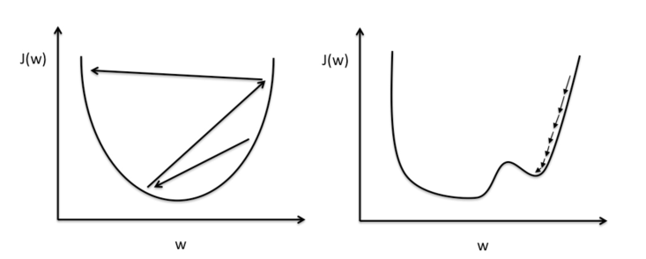
Picking 𝛼 - Adaptive Learning Rates
ADAM, RMSProp, Adagrad, etc.
More Information on Stochastic Gradient Descent and Different Optimization Methods
Notes:
So in practice, there are many optimization methods that are used in practice that can compute the optimal learning rate alpha that would best suit learning. Typically, we use larger learning rates at the beginning (to take bigger steps towards a local minima) and start to slow down as we get closer to the desired value (once again, to not oscillate too much). For non-convex optimization surfaces, which happen for the most part, we need larger learning rates to gain “momentum” and keep on moving towards the desired optimal points. We won’t really be covering these optimization methods, as they require a lot deeper math knowledge.

Slide 37
Coding Demo

Slide 38
Further Readings
Deep Learning Chapter 6 - Ian GoodFellow, Yoshua Bengio, and Aaron Courville
Article of Backpropagation and Gradient Descent
How the backpropagation algorithm works - Michael Nielsen
A Practical Guide to ReLU
Empirical Evaluation of Rectified Activations in Convolution
Network (Xu et al. 2015)
Visualizing Neural Networks from a Manifold Perspective (Olah 2014)

Slide 39
Addition resources on back-propagation
3blue1bown Youtube series

Slide 40
Homework Assignment
Theoretical Recap and Feed Forward Neural Networks
Assignment7-TheoryRecapAndFeedForwardNN.ipynb
Notes:
https://www.w3resource.com/python-exercises/numpy/linear-algebra/numpy-linear-algebra-exercise-1.php
Read up on eigenvectors and eigenvalues

Slide 41
Thanks!
Any questions?
McGill Artificial
Intelligence Society

